Slide 1

Getting The Balance Right
Gavin Crosby – Local Partnership Development Manager - Young Scot
gavinc@young.scot
young.scot (Young People) young.scot.net (Partners)

Slide 2
Young Scot is the national youth information and citizenship charity for Scotland

Slide 3
We want to…
Activate
Creating pathways for young people to navigate positively through times of transition
Empower
Enabling young people to participate and influence change locally, nationally and globally
Connect
Supporting young people to grow, develop and achieve by connecting them to services and opportunities
Supporting young people aged 11-26 to
Learn and grow
Live and thrive
Work and achieve
in order to support them in making meaning of their lives as they grow up and face transitions.

Slide 4
What do we want from a vote?
Low Cost
Robust
High turnout
Pick any 2!
Cash and staff time
1person=1vote (+ eligible)
How many votes is enough?
If we add deliberation phase as well, this becomes even more complicated: Breadth vs Depth vs Capacity

Slide 5
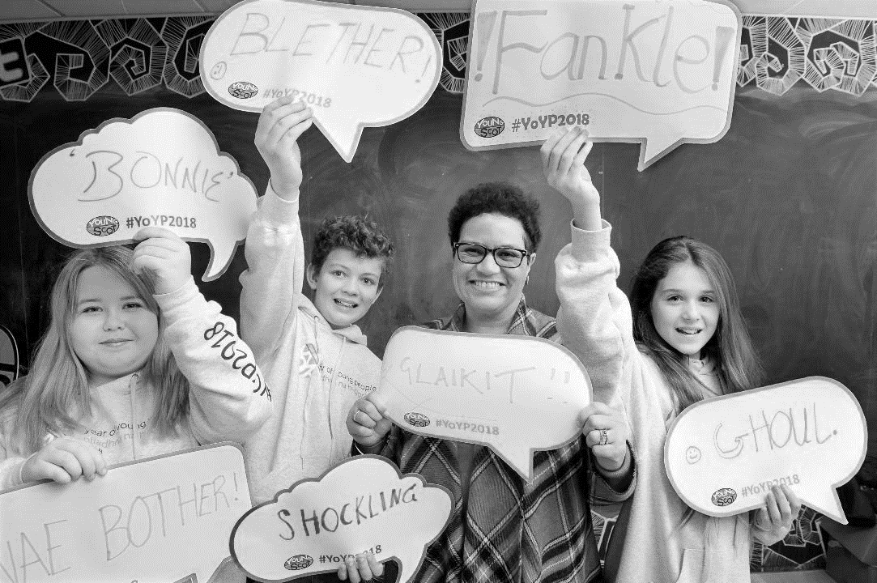
Where are we now?
Successful votes and projects – money is being allocated across communities – to the projects that people value
Engagement, or Re-engagement with communities
Community Building
    BUT:
Who is not part of the process?
Larger/Established groups have an advantage over grassroots/smaller projects?
Not mainstream/core funding yet?

Slide 6
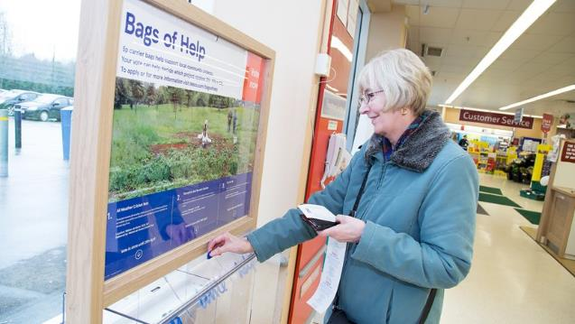
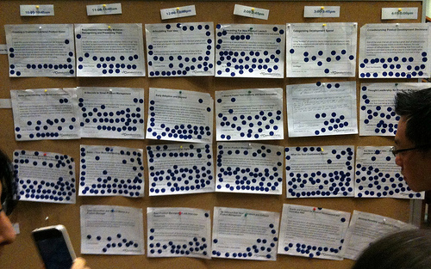
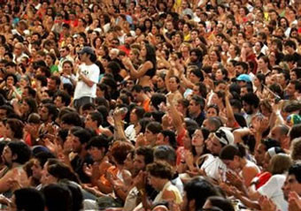
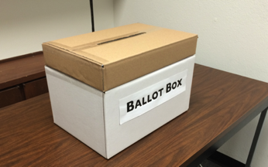

Slide 7
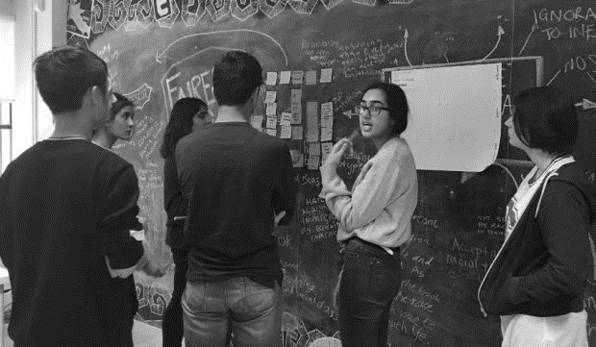
How our system works
Single login using Unique number on the Young Scot Card
FPTP, STV – single or multiple votes
Constituency system – geographic or thematic
Open and close vote during an indefinite period
Instant results
Checking through IP Address, time stamp, and whether a real card or a temp number was used
  No need for personal data
  Quick and easy from any internet device
  1 number = 1 vote
  We supply ‘temporary numbers’ for those without a Young Scot card.

Slide 8
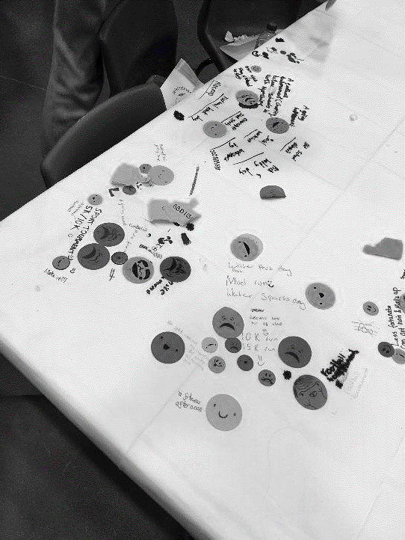
Young Scot Experience
Online voting since 2011
At least 100,000 individuals have voted online in that time
Over 300,000 total votes cast
Scottish Youth Parliament votes
  Some constituencies report better turnout than local council elections
Participatory Budgeting activity
  10 Local Authorities
  7,000 votes in one round in North Ayrshire
  Moray likely to get 7,000 over 7 separate votes

Slide 9
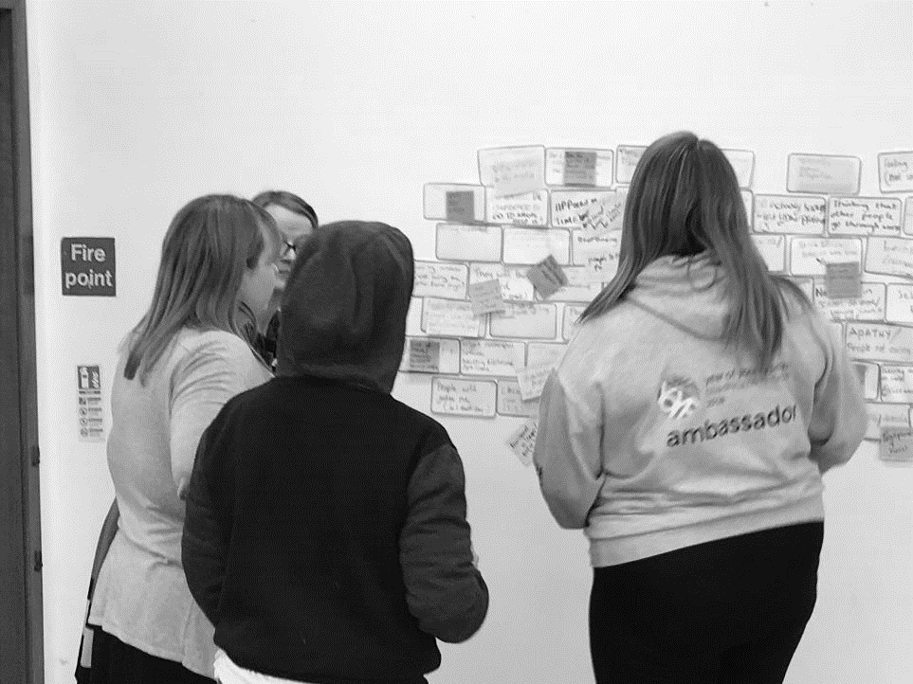
However…
Idea generation, deliberation and project creation is still face to face
Still a need for workers to promote any vote – staff capacity in youth work teams is reducing
Young people’s funds tend to be low financial value (~£1k-5k)
Anecdotally – some votes become a popularity contest
LGBTQI issues well represented, but other equalities groups are missing from applications

Slide 10
Not either online or face to face – Have both!
Some concern that digital voting will take away from the ‘community feel’ of face to face events
No reason not to combine – vote using phones, tablets, computers at and during the event!
Moray votes, phone in at end of event, result announced in the room 2 minutes later
Use our system, Mentimeter, survey monkey etc.

Slide 11
A Balancing Act…
Ease of access
Simple to understand
Wide reach
Voter choice
Robustness
‘Genuine’ process
‘Connection’ with the voters
Issues not personalities

Slide 12
What’s next?
Developments to the platform (Integration with the Consul platform – Simon speaking later!)
  Linking with the My Account System
  Integrating with the rest of the Young Scot offer – mobile optimised to ensure young people get information about votes, events, consultation etc locally to them.
‘No meaningful participation without information’ – ensuring a comprehensive youth information platform to allow meaningful engagement
Continuing to work with Local Authorities – key to enabling communities to create ideas

Slide 13
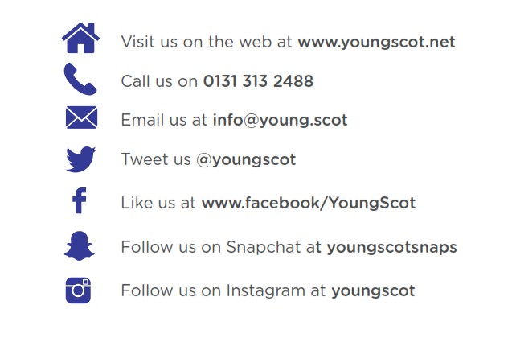
Get in touch…

