Slide 1
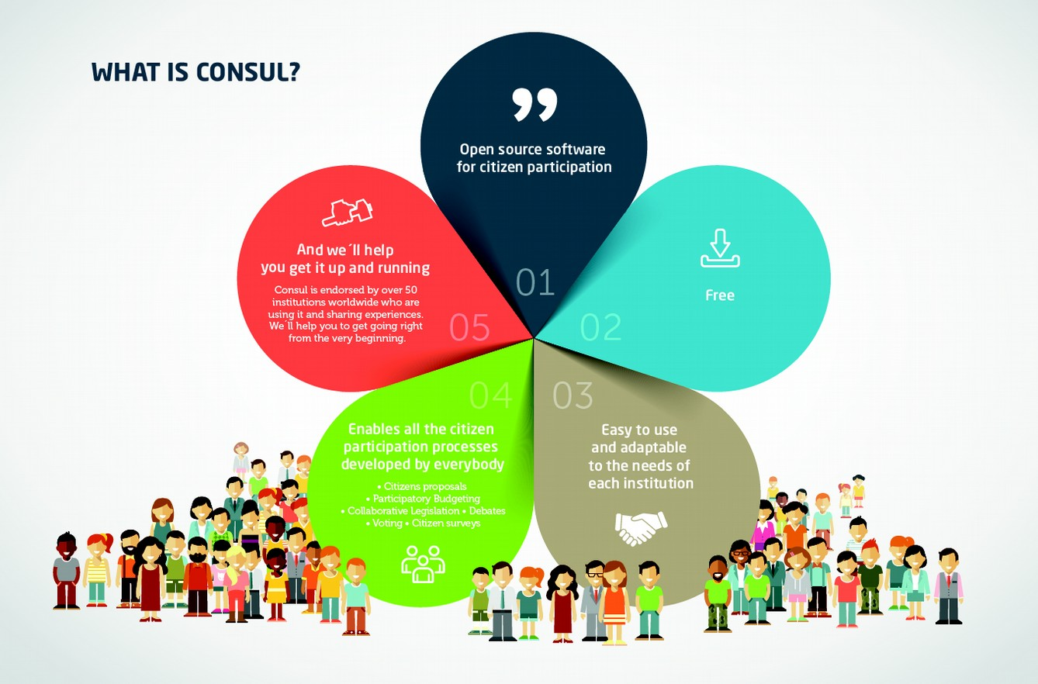
Scottish Digital Pilot
Consul

Slide 2
CONSUL
A digital tool for citizen participation enabling open, transparent and democratic engagement between public bodies and communities
Software developed by Madrid City Council and currently used by 100 cities in 55 countries across the world
In Scotland 16 local authorities are signed up to CONSUL…and counting
Five key elements:
Debates
Proposals
Voting
Collaborative Legislation
Participatory Budgeting

Slide 3
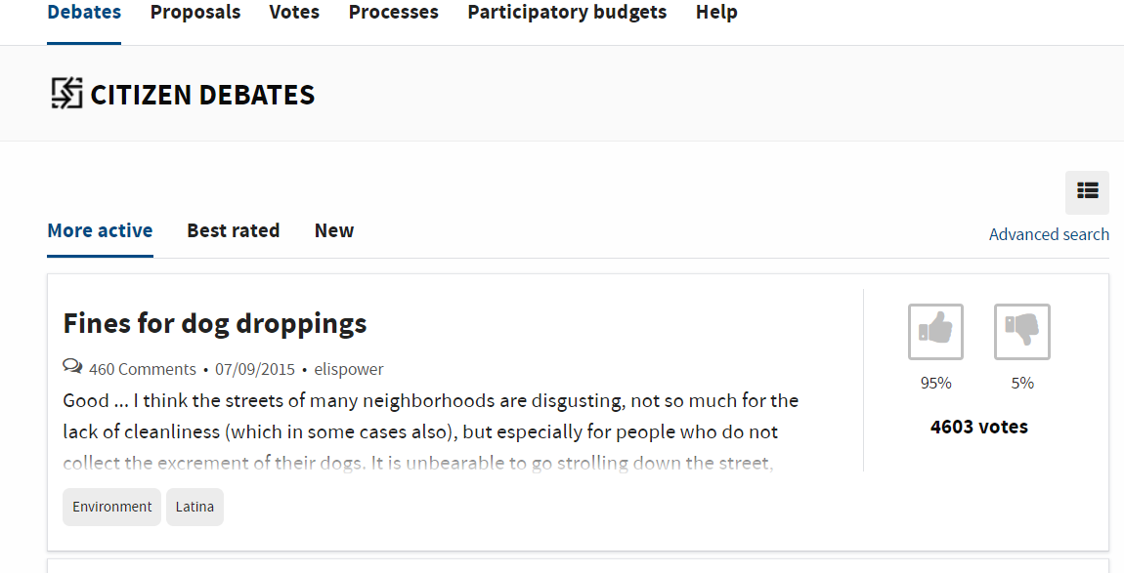
Debates
Notes:
Enables people to express the issues that are important to them
Creates space for listening, collaboration and sharing of issues and ideas
People can share their opinion on debates (like or dislike)
All discussions have a comments section where users can debate. Comments can also be liked or disliked.
Officers can open a debate, as well as respond to any comments. Their input is highlighted to give them more visibility

Slide 4
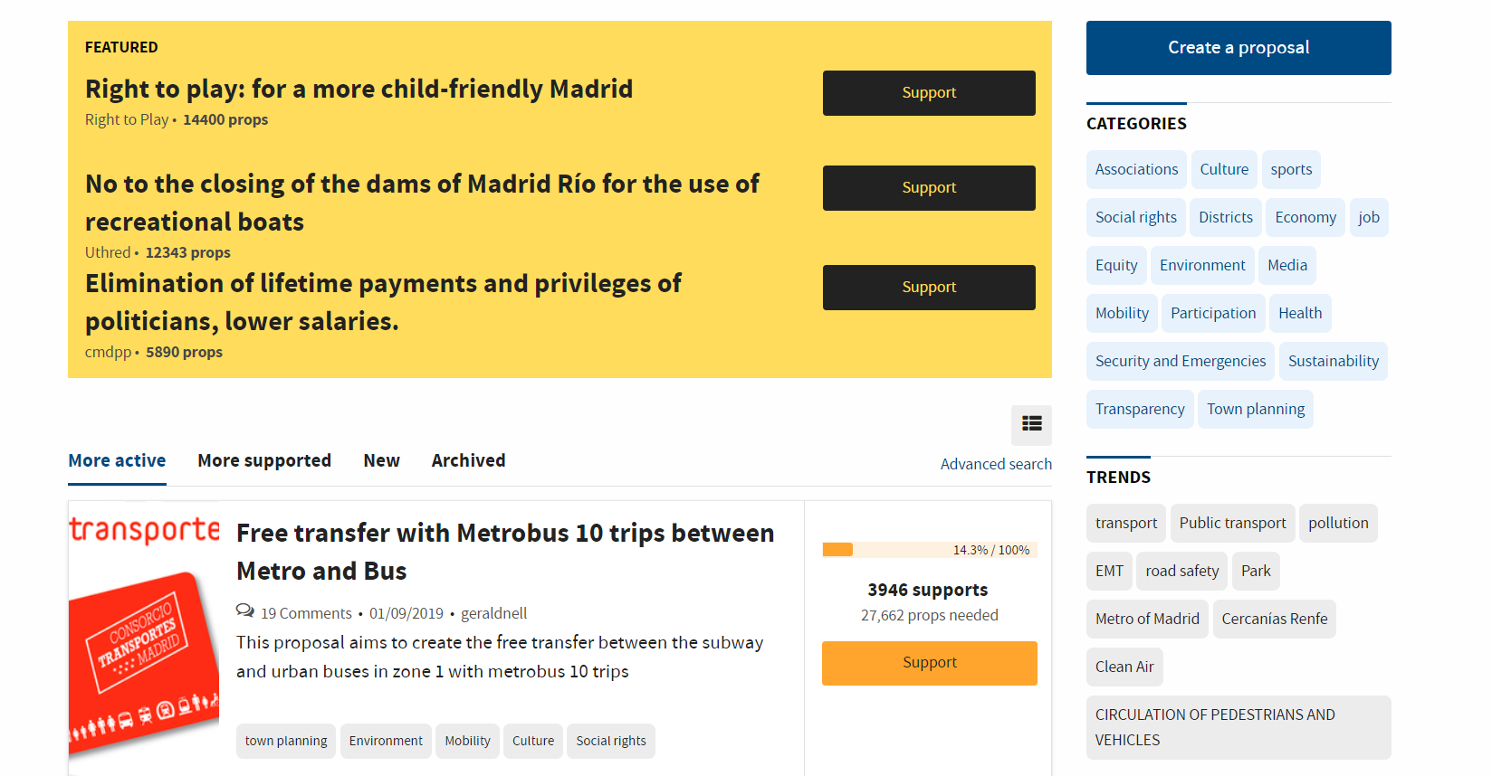
Proposals
Notes:
People can submit proposals at any time on a subject or issue
Proposals can gather ‘supports’ up to an agreed threshold.
When the threshold is reached, the proposals can be moved to the voting section, where a vote can be taken for or against the proposal, or be directly considered to be carried out by the public body
Proposals can include tags, images, documentation, videos, map location or other relevant information.
There is comment space where anyone can discuss the proposal, as well as vote on comments

Slide 5
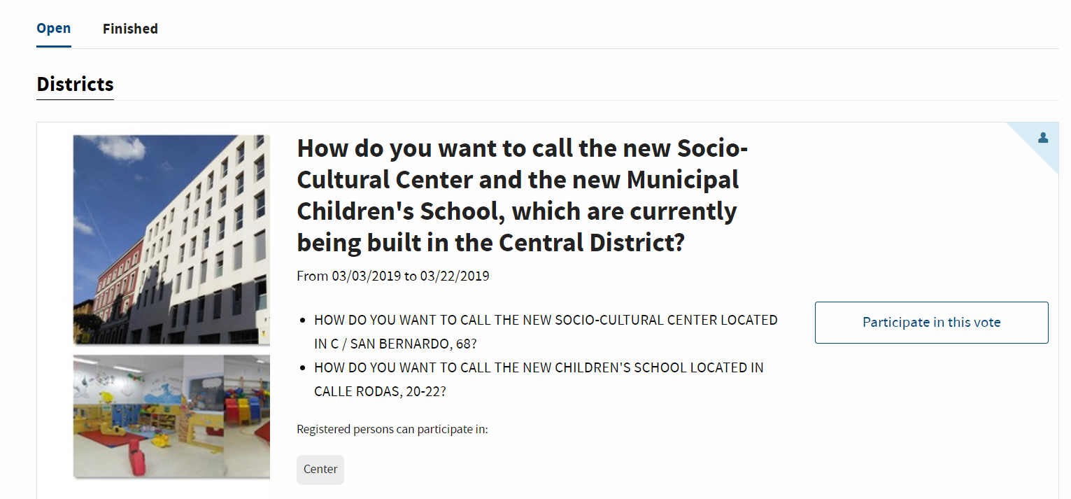
Voting
Notes:
The voting module allows people to vote on citizen’s proposals
The local authority may ask citizens to vote on specific options within a proposal
Each of the voting options can include images, text, videos, etc.
Voting can be configured to involve all users, or only users in certain local authority areas

Slide 6
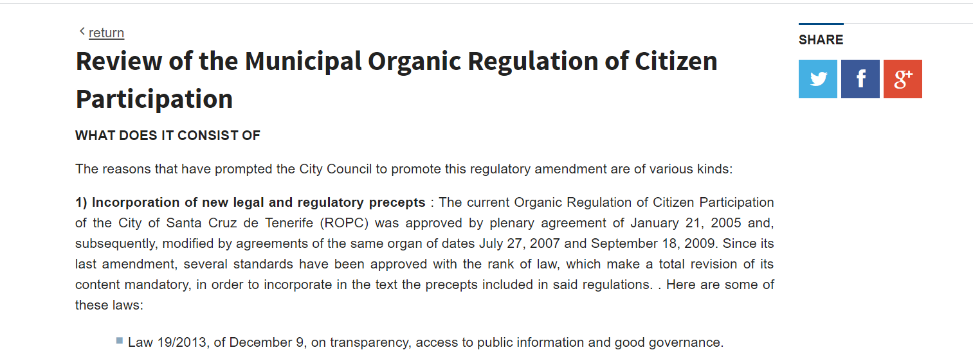
Collaborative Legislation
Notes:
A space to propose and discuss legislation and open documents for consultation
Carried out mainly in three phases:
Phase One
May consist of an initial discussion. It is common to use this phase when the process begins and no initial document is available. It is useful for deciding the main issues to be addressed and steering the process in the most appropriate direction.
There are then questions about the main issues of the topic to be addressed, which users will be able to answer openly
Users can answer questions, debate with other people and vote on answers
Phase Two
A second phase may consist of selecting the best ideas to include in the document/plan. You can publish the ideas that have been worked on by the local authority and open it up to people to propose their own ideas. All ideas can be supported to identify which ones have the greatest approval
Phase Three
The document/plan can be published and users can select any part and add comments.
In addition, comments can be voted on, allowing local authorities and citizens to see where there is support and which are the most appealing

Slide 7
Participatory Budgeting
Notes:
Allows citizens to directly propose and decide how to spend part of a local authority’s budgeting is spent. Any registered user can make proposals and vote on the ideas of others. The most voted proposals will be carried out.
The budget can be divided different categories/areas and the local authority can decide how they would like people to participate. For example, in a city you can create two budgets: one for projects that affect the whole city and another for projects that only affect a specific area. Another possibility would be to make thematic groups, distributing a part of the budget for a specific theme: education, health, transparency, etc.
The PB element of the platform typical splits the process into phases; some or all of which can be used. The available phases are as follows:
Presentation of projects (Idea Generation) - Citizens can submit budget expenditure projects.
Initial review of projects - During this phase it is no longer possible to submit projects, but they still cannot be supported or voted on. It is a useful phase for all users to see their projects published, and to detect and correct any errors that exist.
Support phase - This phase allows users to support projects. It is common to receive more projects than can be evaluated in the next phase, so this phase allows prioritisation and to determine which projects should be evaluated at the next phase based on the number of supports
Evaluation of projects - During the evaluation period, projects can be evaluated by the local authority. This evaluation process allows the local authority to decide which projects are viable or unfeasible, and assign he viable projects a cost. Evaluated viable projects move on to the voting phase.
Final vote - Users can vote on projects to decide which are successful. The projects have all the functionalities that are available in the Proposals section (see more information in that section)
During the final voting phase a "shopping cart" type voting can be used. Each person will have the full budget to spend, and will be able to vote on projects based on their cost until the budget is spent.

Slide 8
And finally…
CONSUL can and does enhance ‘face to face’ engagement rather than replace it
Allows for consistent, open and transparent engagement and communication between citizens and local authorities through all elements
Can be tailored to meet the needs of local authorities and its communities…all parts of the site don’t need to be ‘switched on’ at once

Slide 9
Further information
https://decide.madrid.es/ (website used for presentation)
www.consulproject.org (for further information on the platform and web links for other CONSUL sites)

Slide 10
Contact
simonc@cosla.gov.uk
Development Manager, Participatory Budgeting
Tel: 0131 474 9261
jillian@cosla.gov.uk
Training Officer, Participatory Budgeting
katey@cosla.gov.uk
Social Inclusion Officer, Participatory Budgeting
Participatory Budgeting Website
www.PBScotland.scot
www.cosla.gov.uk @cosla COSLA

